Slide 1
Age Classification
By: Shanshan Gong, Qichen Huang, Yushan Wang

Slide 2
Goals
We will be establishing, training and deploying models for getting the ability to automatically estimate the accurate age solely from facial images of a person.

Slide 3
Challenges/Concerns
Challenge 1
Challenge 2
Challenge 3
What data set to use?
The current built data set in the Adience Benchmark Project
Automatically generated human-faces
Identifying the definition of face detection.
Face detection has a different definition than face classification
We need an individual module to achieve the need of face detection.
What architecture or which classification model should we use to output the corresponding age to the input image.

Slide 4
Research and Related Literature Reviews

Slide 5
Adience Benchmark
Published in 2014
Contains 26,580 photos across 2,284 subjects
Partitioned into five splits
Binary gender label & one label from eight different age groups
Does not include extreme cases

Slide 6
Age Classification
Demand for age classification using facial images has increased in recent years
Age estimation methods in the early stage are based on the different measurement of facial feature landmark ratios.
As the regression and deep learning models being deployed, Tal Hassner deployed a deep convolutional neural network as a model for the classification.

Slide 7
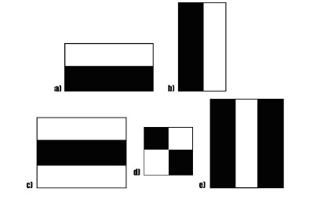
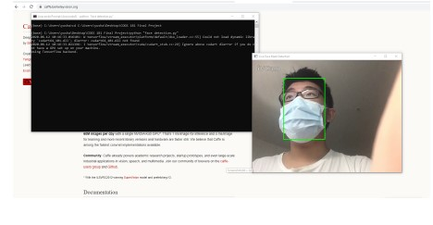
Face Detection
Haar Cascades Classifier
Deep Neural Network (DNN)
A demonstration of the Haar Cascade
demonstration of the caffe-DNN working in the
extreme condition.

Slide 8
Design Solutions

Slide 9
CNN for Age Classification
Reproduce the deep convolutional neural network architecture presented by Gil and Tal Hassner
Experiment with a few different architectures to see if could outperform the current result
Improve their models.
Train the model and choose specific parameters that are optimal
Test using sample images

Slide 10
Face Detection
experiment four pre-trained models, test and choose the optimal one
deployment
Webcam
IOS devices
Cloud configuration

Slide 11
Implementation Steps

Slide 12
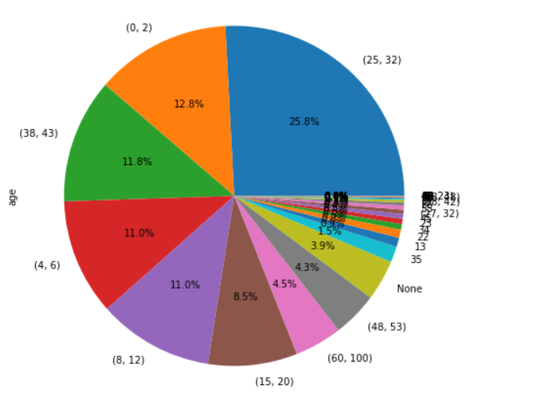
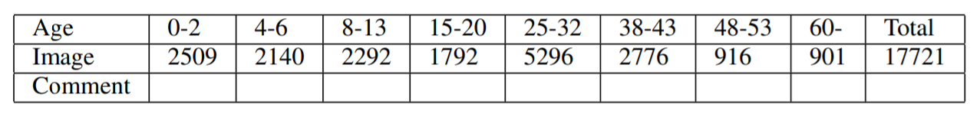
Adience Benchmark
Analysing the data set by creating a pie chart
Classifying the edge cases
Note that we excluded the images that does not have a age label, total 17,721 images

Slide 13
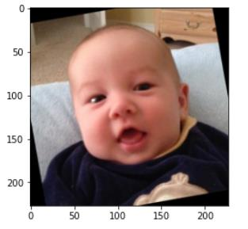
Data Processing
Performed a center cropping with a uniform size of 227x227.

Slide 14
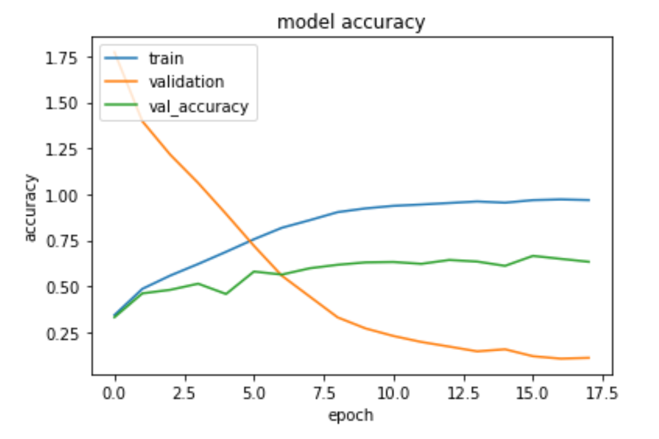
Simplification
Choosing AlexNet, which is a 5 fully connected convolutional layer network, published by Alex Krizhevsky.
reproduce the CNN architecture in TensorFlow
Initial training and monitoring

Slide 15
Training and Testing
with 2 more Convolutional layer, the model converges faster than the Tal’s model
the eventual test accuracy was between 60%-65%

Slide 16
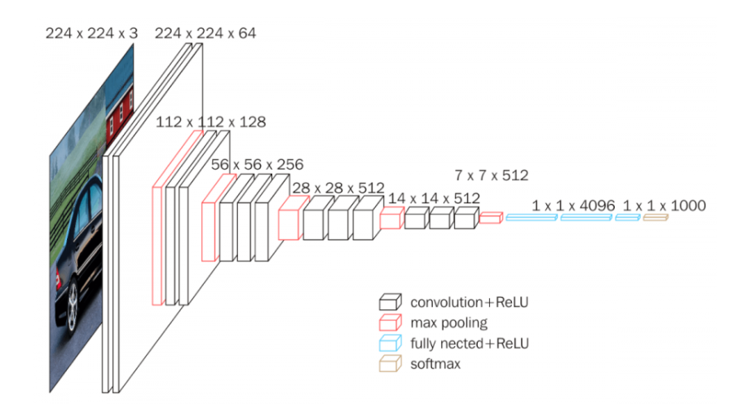
VGG-16 by K. Simonyan and A. Zisserman
used to cross-compare the result of our CNN classifier
deployed this model to perform a transfer learning
we have achieved considerable accuracy using this strategy (higher than AlexNet)

Slide 17
Lessons Learned
Working with Tal Hassner’s results and improved it.
Learned a lot from The Adience Benchmark Project, we solved problems that exist in the original model.
Acquired much useful experience in image processing when we are handling the image inputs
Gained experience on using OpenCV
Notes:
Appearance does not solely depend on the age of a person, living environments and health status all affects the person’s appearance which can affect the accuracy of our model, so we cannot simply rely on this model to determine one’s age.

Slide 18
Next Steps
Increase Accuracy
Reduce Cost
Deployment
Experiment with more models
More pre-processing procedures
local machine with a 3840 CUDA cores and 16 Gigabytes of video memory.
Training each network is about 10-15 minutes.
Deploy on IOS devices using CoreML
Notes:
We are also working on deploying it to other platforms which includes apple device using CoreML and the cloud
Noticing that there are a large number of photos that show only part of a person’s face while the rest are blocked by accessories such as sunglasses, hats, and other things
Given the fact that people do not always face directly toward the camera, we should also work on trying to determine the age of those people who have their head tilted and turned sideways.

Slide 19
Result
We finished building the age classification model, and successfully deployed to our webcam application.
We examined the CNN model architecture developed by the Gil and Tal’s model. The accuracy was between 60%-65% and we found a little over-fitting of that model.
Our model based on the VGG-16 eventually could reach an accuracy between 67%-72%.
Our model outperform the convolutional neural network architecture in the Gil and Tal’s model.
Github link/MVP:
https://github.com/yushan1089/ST8601_Age_detection

